Slide 1

Week 5
Physical Layer : Wireless Networks

Slide 2
Outline
History
Benefits
Time/frequency domain concepts
802.11 standards
802.11 Mac algorithm
Summary
Conclusion

Slide 3
History
1880: Hertz discovered electromagnetic waves
1898: First commercial radio data service
1921: First Mobile Radio
1946: First Mobile Telephone Service In St. Louis by AT&T. Half-duplex
1970: First Cellular Phone Service In Chicago by AT&T w cell, handoff, and roaming
1971: First Wireless Data Network Aloha at University of Hawaii
1990: First Commercial Wireless LAN Product AT&T WaveLAN
1997: First Wireless LAN Standard - IEEE 802.11 2Mbps

Slide 4
Wired Vs. Wireless Communication
Wired | Wireless
Each cable is a different channel
One media (cable) shared by all
Signal attenuation is low
High signal attenuation
No interference
High interference
noise; co-channel interference; adjacent channel interference

Slide 5
Benefits

Slide 6
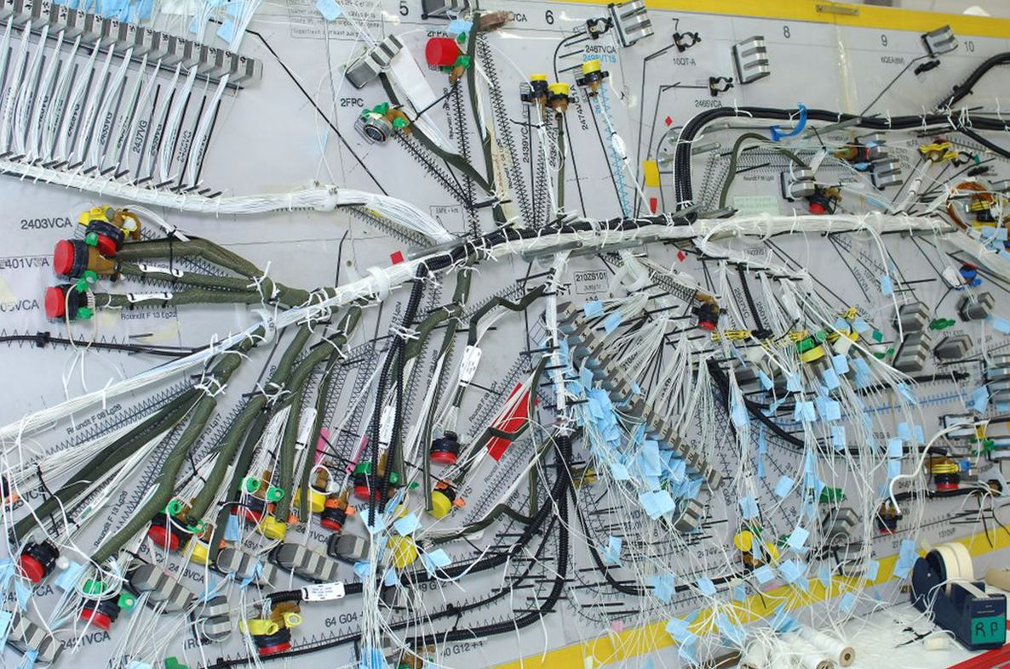
Benefits of Wireless
-Reduced manufacturing complexity
-Reduced weight
-More reliable – less physical connections
-Easier to maintain / modify after production
-Any other?
Airbus A319 wiring loom (from www.lia-tech.com)
Notes:
Airbus pic. Need details

Slide 7
Why go wireless ?
Advantages
Sometimes it is impractical to lay cables
User mobility
Cost
Limitations
Bandwidth
Fidelity
Power
(In) security

Slide 8
Some facts
1.35 Billion mobile subscribers vs 1.2 Billion Fixed line subscribers at the end of 2003

Slide 9
IEEE top 10 downloads

Slide 10
Issues

Slide 11
Issues
Security
Higher data rates (60GH ???)
Multiple In Multiple Out (MIMO) antennas: IEEE 802.11n
Seamless Networking ⇒ Handoff (IEEE 802.21)
Multimedia over Wireless: Media center extenders , VOIP/Video over cell phones
Channel congestion in license-exempt band

Slide 12
Applications - LAN Extension
Saves installation of LAN cabling
Eases relocation and other modifications to network structure
However, increasing reliance on twisted pair cabling for LANs
Most older buildings already wired with Cat 3 cable
Newer buildings are prewired with Cat 5e or 6
Wireless LAN to replace wired LANs has not happened
In some environments, role for the wireless LAN
Buildings with large open areas
Manufacturing plants, stock exchange trading floors, warehouses
Historical buildings
Small offices where wired LANs not economical
May also have wired LAN
Servers and stationary workstations

Slide 13
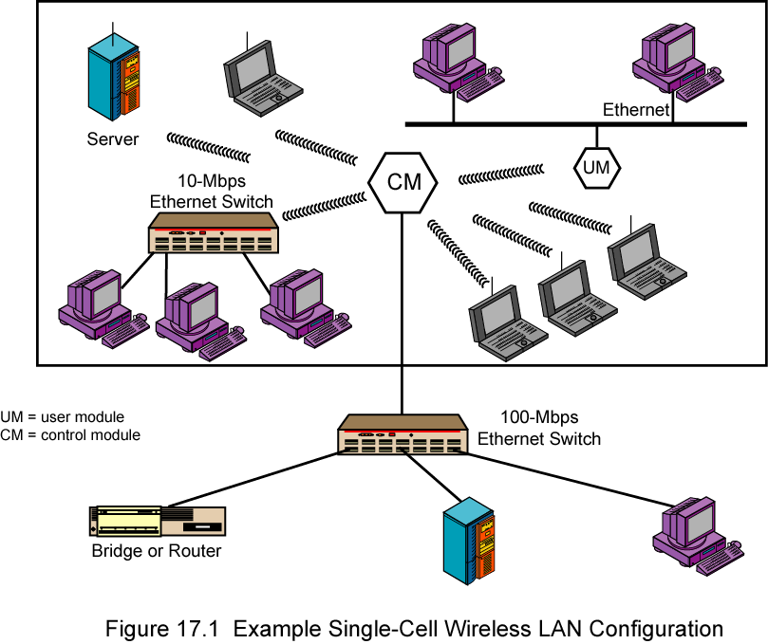
Single Cell Wireless LAN Configuration

Slide 14
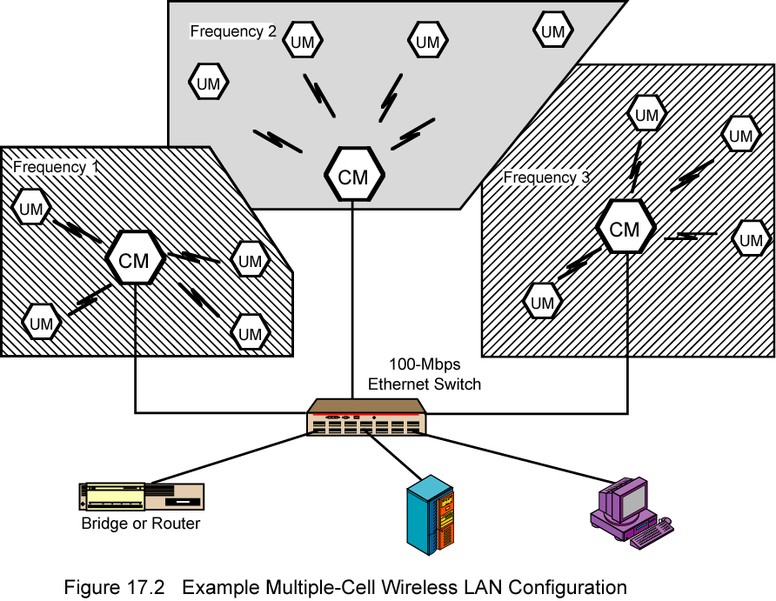
Multi-Cell Wireless LAN Configuration

Slide 15
Applications – Cross-Building Interconnect
Connect LANs in nearby buildings
Point-to-point wireless link
Connect bridges or routers

Slide 16
Applications - Nomadic Access
Link between LAN hub and mobile data terminal
Laptop or notepad computer
Enable employee returning from trip to transfer data from portable computer to server
Also useful in extended environment such as campus or cluster of buildings
Users move around with portable computers
May wish access to servers on wired LAN

Slide 17
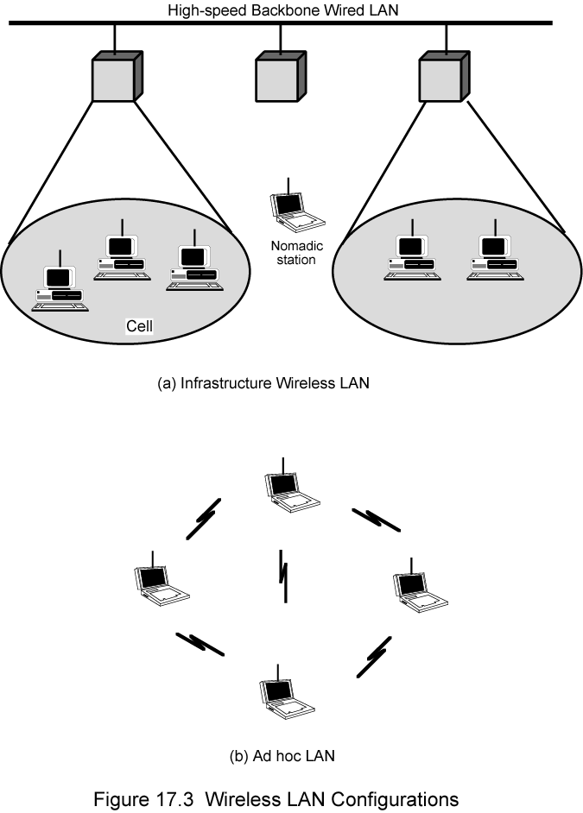
Infrastructure Wireless LAN

Slide 18
Applications – Ad Hoc Networking
Peer-to-peer network
Set up temporarily to meet some immediate need
E.g. group of employees, each with laptop or palmtop, in business or classroom meeting
Network for duration of meeting

Slide 19
Add Hoc LAN

Slide 20
Wireless LAN Requirements
Same as any LAN
High capacity, short distances, full connectivity, broadcast capability
Throughput: efficient use wireless medium
Number of nodes:Hundreds of nodes across multiple cells
Connection to backbone LAN: Use control modules to connect to both types of LANs
Service area: 100 to 300 m
Low power consumption:Need long battery life on mobile stations
Mustn't require nodes to monitor access points or frequent handshakes
Transmission robustness and security:Interference prone and easily eavesdropped
Collocated network operation:Two or more wireless LANs in same area
License-free operation
Handoff/roaming: Move from one cell to another
Dynamic configuration: Addition, deletion, and relocation of end systems without disruption to users

Slide 21
Technology
Infrared (IR) LANs: Individual cell of IR LAN limited to single room
IR light does not penetrate opaque walls
Spread spectrum LANs: Mostly operate in ISM (industrial, scientific, and medical) bands
No Federal Communications Commission (FCC) licensing is required in USA or Ofcom in UK
Narrowband microwave: Microwave frequencies but not use spread spectrum
Some require FCC licensing

Slide 22
Infrared LANs Strengths and Weaknesses
Spectrum virtually unlimited
Infrared spectrum is unregulated worldwide
Extremely high data rates
Infrared shares some properties of visible light
Diffusely reflected by light-colored objects
Use ceiling reflection to cover entire room
Does not penetrate walls or other opaque objects
More easily secured against eavesdropping than microwave
Separate installation in every room without interference
Inexpensive and simple
Uses intensity modulation, so receivers need to detect only amplitude
Background radiation
Sunlight, indoor lighting
Noise, requiring higher power and limiting range
Power limited by concerns of eye safety and power consumption

Slide 23
Spread Spectrum LANs Hub Configuration
Usually use multiple-cell arrangement
Adjacent cells use different center frequencies
Hub/AP is typically mounted on ceiling
Connected to wired LAN
Connect to stations attached to wired LAN and in other cells
May also control access
IEEE 802.11 point coordination function
May also act as multiport repeater
Stations transmit to hub and receive from hub
Stations may broadcast using an omnidirectional antenna
Logical bus configuration
Hub may do automatic handoff
Weakening signal, hand off

Slide 24
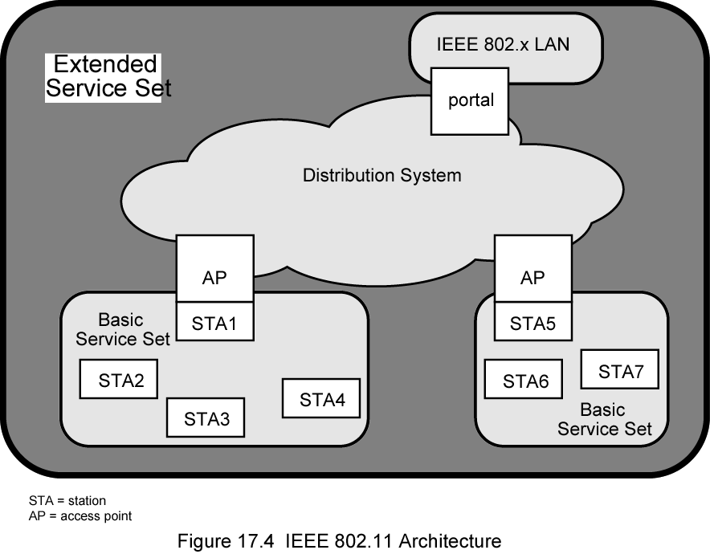
IEEE 802.11 Architecture

Slide 25
802.11 Physical Layer
Issued in four stages
First part in 1997
IEEE 802.11
Includes MAC layer and three physical layer specifications
Two in 2.4-GHz band and one infrared
All operating at 1 and 2 Mbps
Two additional parts in 1999
IEEE 802.11a
5-GHz band up to 54 Mbps
IEEE 802.11b
2.4-GHz band at 5.5 and 11 Mbps

Slide 26
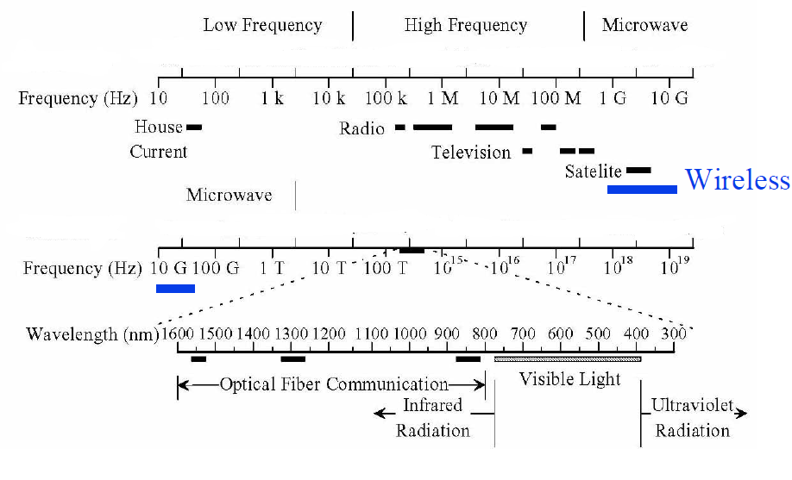
Spectrum

Slide 27
Electromagnetic Signal
Function of time
Can also be expressed as a function of frequency
Signal consists of components of different frequencies
Notes:
EM signal is used as a means to transmit information. EM is a function of time but it can also be expressed as a function of frequency
That is the signal consists of components of frequencies. However, the frequency domain view of a signal is more important.

Slide 28
Concepts Related to Channel Capacity
Data rate - rate at which data can be communicated (bps)
Noise - average level of noise over the communications path
Error rate - rate at which errors occur
Error = transmit 1 and receive 0; transmit 0 and receive 1

Slide 29
Rule of thumb
As we select higher frequency for TX the Channel Capacity increases
As the frequency increases the EMW starts behaving as light
At higher frequency radio cannot penetrate walls , fog etc (60GHz)
The larger the antennas the long distance it will travel

Slide 30
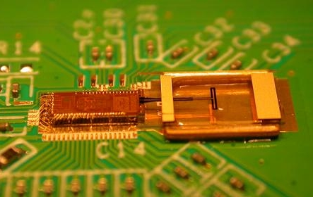
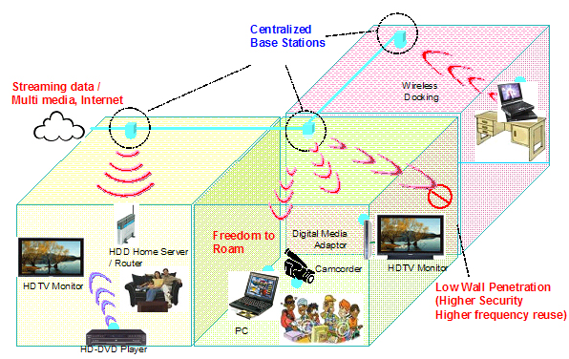
Example 60 GHz?
IBM 60 GHz chip with integrated dipole antenna
High bandwidth / channel re-use

Slide 31
CSMA/CA
Listen before talk
4 way handshake

Slide 32
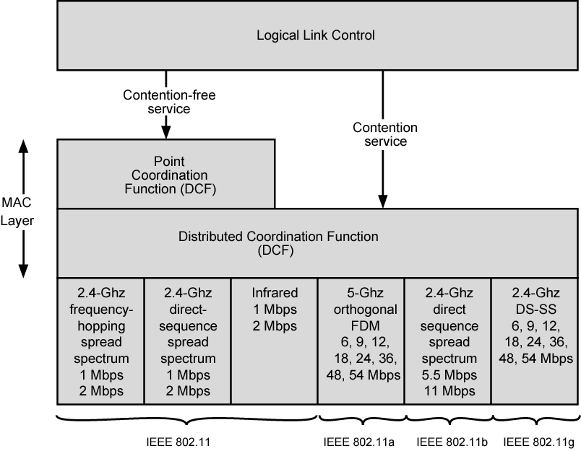
IEEE 802.11 Protocol Architecture

Slide 33
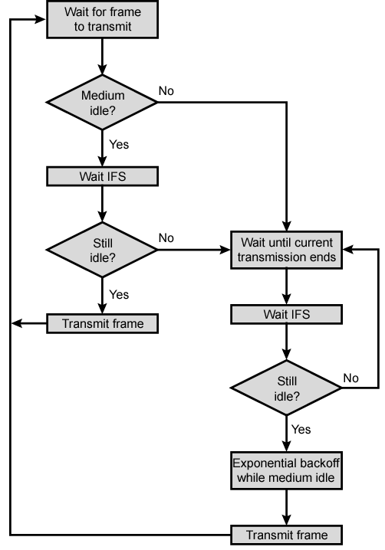
IEEE 802.11 Medium Access Control Logic

Slide 34
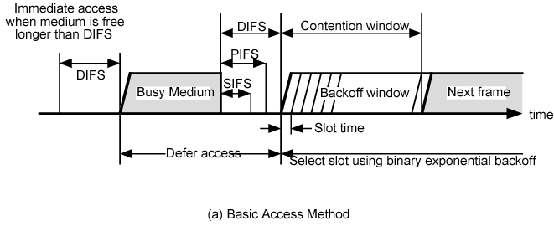
IEEE 802.11 MAC Timing Basic Access Method

Slide 35
802.11?
802.11 e .....QoS multimedia
802.11h.......dynamic channel selection
802.11i.......Security
802.11n.......Enhanced throughput
802.11p....... Inter-vehicle and vehicle-road side communication at 5.8GHz
802.11s: Mesh Networks

Slide 36
Bluetooth
Sony ericson
Danish king...blue tooth...found of blueberries
Later Intel , Nokia and Ericson joined in 1998
IEEE 802.15.1
2.4GH
10m
1Mb/s new version is 3Mb/s
Key Feature
Low power
Cheap
V small 9 mm2

Slide 37
Piconnet
Network formed by bluetooth
1 master and 6 slaves
Slaves are polled by master for TX

Slide 38
Other IEEE Standards I
IEEE 802.16: Broadband Wireless Access / WirelessMAN / WiMax
- wireless distribution system, e.g., for the last mile, alternative to DSL
- 75 Mbit/s up to 50 km LOS, up to 10 km NLOS; 2-66 GHz band
- initial standards without roaming or mobility support
802.16e adds mobility support, allows for roaming at 150 km/h

Slide 39
Other IEEE Standards III
IEEE 802.21: Media Independent Handover Interoperability
standardize handover between different 802.x and/or non 802 networks

Slide 40
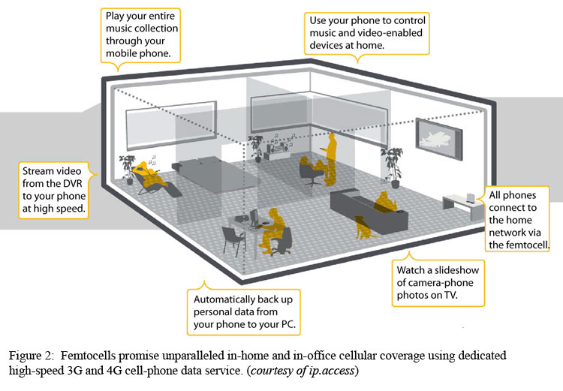
Femtocell

Slide 41
Questions

